Slide 1
Greeks
How to Manage your Portfolio

Slide 2
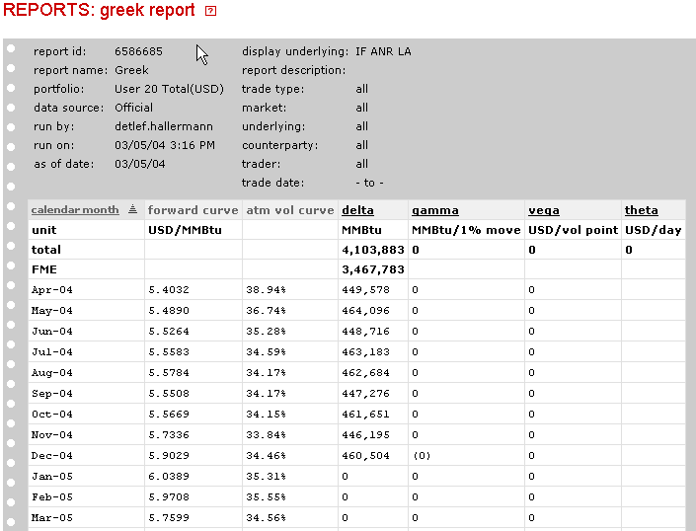
Greek Report

Slide 3
Greeks
What are Greeks
Delta
Gamma
Theta
Vega
Rho
What can be inferred by the Greeks and their changes in the portfolio

Slide 4
Initial Thoughts

Slide 5
Delta
Delta is
the first derivative of the option price in relation to the underlying asset
the rate of change in the derivative price with a change in the underlying price
the velocity that the option value changes as the underlying changes

Slide 6
Derivative Value vs. Underlying Value
Delta = slope of the line
Underlying Profit / Option Value
Underlying Price/Value
Slope of the line is 45º at the money
Δ = 1
45º

Slide 7
Delta for a Forward/Futures Contract
As the underlying increases by $0.01, the Futures price increases by $_.__
Thus, the is 1 for a forward or futures contract
It is not the same for an option

Slide 8
Equations for an Option

Slide 9
Equations for an Option
Call Option
Put Option
Price of the Underlying Asset
Strike Price
Normal Distribution function
Risk-free rate
Contract Tenure
Volatility

Slide 10
Delta for an Option

Slide 11
Derivative Value vs. Underlying Value
1
Delta is:
Close to 0 when far out-of-the-money
Close to abs(1) when far in-the-money
~0.5 when at-the-money
Delta
0
-1
ATM
Underlying Price/Value

Slide 12
Derivative Value vs. Underlying Value
Further Out of the money
In the money
Delta
At the money
Out of the money
Further Out of the money
T = 0
(at maturity)
T = T
(far from maturity)
Time to Maturity

Slide 13
Gamma
Gamma is
the second derivative of the option price in relation to the underlying asset
the rate of change in the derivative price change with a change in the underlying price
The rate of change if the option’s delta
the acceleration of the option value change as the underlying changes

Slide 14
Gamma Equations

Slide 15
Velocity & Acceleration
If the car is the price of an option
The car’s velocity is Δ
The car’s acceleration is Γ

Slide 16
Gamma Shapes over time
Slightly Negative Gamma – Written option far from maturity
Large Negative Gamma – Written Option near Maturity
Slightly Positive
Gamma - Written option far from maturity
Large Positive Gamma – Holding near maturity option

Slide 17
Gamma Shapes
In the money
At the money
Delta
Gamma
Closer to the money
At the money
Away from the money
Out of the money
Further Away from the money
T = 0
(at maturity)
ATM
T = 0
(at maturity)
ATM
Time to Maturity
Time to Maturity

Slide 18
Gamma Notes
At-the-money: gamma is at a maximum as the option nears expiration
Out-of-the-money: gamma is at a maximum when the option is far from maturity
Gamma is time dependent (see following slide)
Implication:
Traders can add a ST or LT option trade to a book to hedge gamma but increases LT position instability

Slide 19
LT v.s. ST Positions
Book
6 month gas option with a strike at-the-money of $4.50
3 month gas option with a strike at-the-money of $4.50
3 Month Option
Gamma
6 Month Option
ATM
Gamma = 100

Slide 20
Theta (Time Decay, Carry Cost or Rent)
Theta is
the first derivative of the option price in relation to time
the rate of change in the derivative price as the option moves closer to expiration
the velocity that the option value changes as time moves forward

Slide 21
Theta

Slide 22
Theta Trends
Time to Maturity
Far from the money
Near the money
At the money
T = 0
(at maturity)

Slide 23
Vega (also known as zeta or kappa)
Vega is
the first derivative of the option price in relation to the volatility
the rate of change in the derivative price with a change in the volatility
the velocity that the option value changes as volatility changes

Slide 24
Vega Equations

Slide 25
Vega Trends
At the money
Near the money
Vega
Far from the money
T = 0
(at maturity)

Slide 26
Vega & Theta Trends
VEGA
Away from the money
At the money
Near the money
THETA
T = T
T = 0

Slide 27
Alpha (Gamma Rent)
Alpha:
Is the ratio of gamma over theta
Is an indicator of the quality of earnings from gamma
High alpha: the trader is risking heavy theta for gains in gamma
Low alpha: the trader is risking little theta for gains in gamma

Slide 28
Alpha
Holding all else constant
Alpha remains constant as an option moves toward expiration
Alpha represents the relationship between the change in implied volatility and change in time decay

Slide 29
Fair-Value Alpha
Fair-Value Alpha is the calculated alpha when interest rates are set to zero

Slide 30
Spread Fair-Value Alpha
Fair-Value Alpha is the calculated alpha when interest rates are set to zero

Slide 31
Fair-Value Alpha
General Rule (using Law of Large Numbers):
Losing position if:
Gaining position if:

Slide 32
Rho
Rho is
the first derivative of the option price in relation to the interest rates
the rate of change in the derivative price with a change in the interest rates
the velocity that the option value changes as interest rates change
The risk associated with financing the premium

Slide 33
Rho Equations

Slide 34
Rho Trend

Slide 35
Secondary Greeks

Slide 36
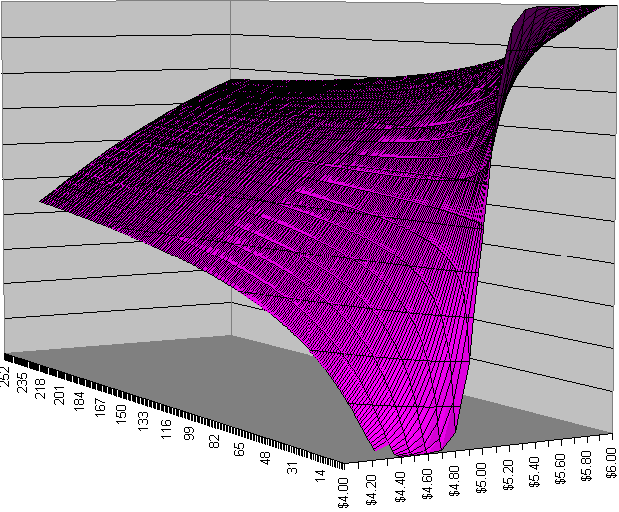
Delta Call ($5 strike)

Slide 37
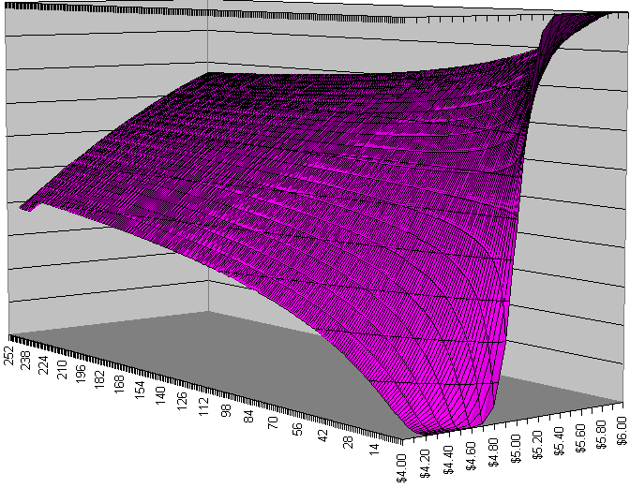
Delta Put ($5 strike)

Slide 38
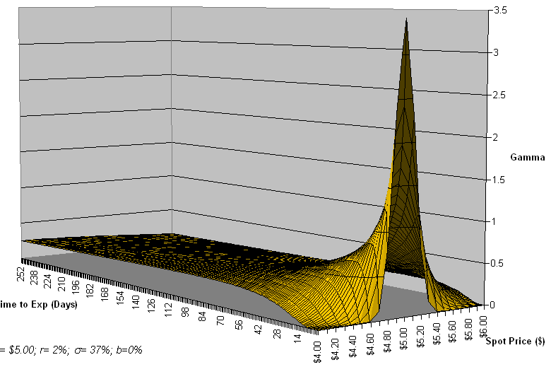
Gamma ($5 strike)

Slide 39
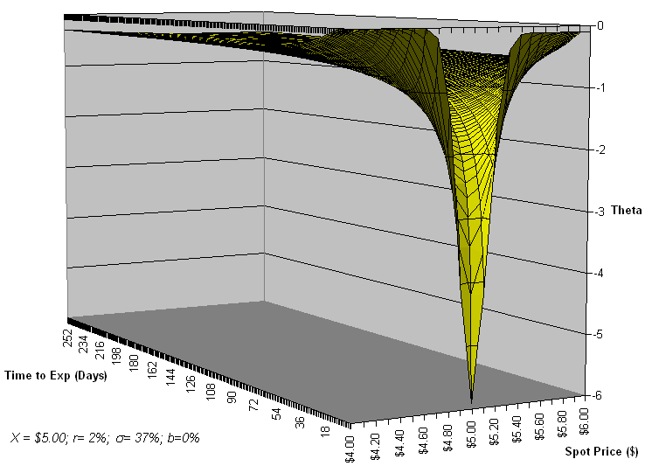
Theta Call ($5 strike)

Slide 40
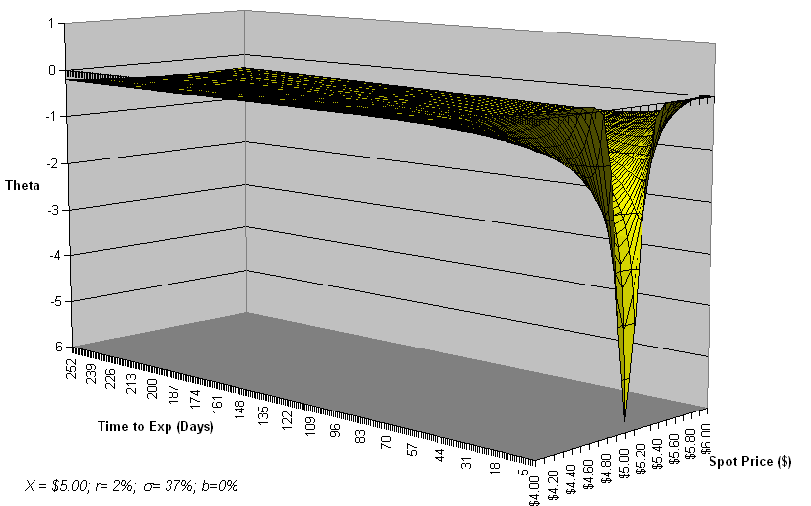
Theta Put ($5 strike)

Slide 41
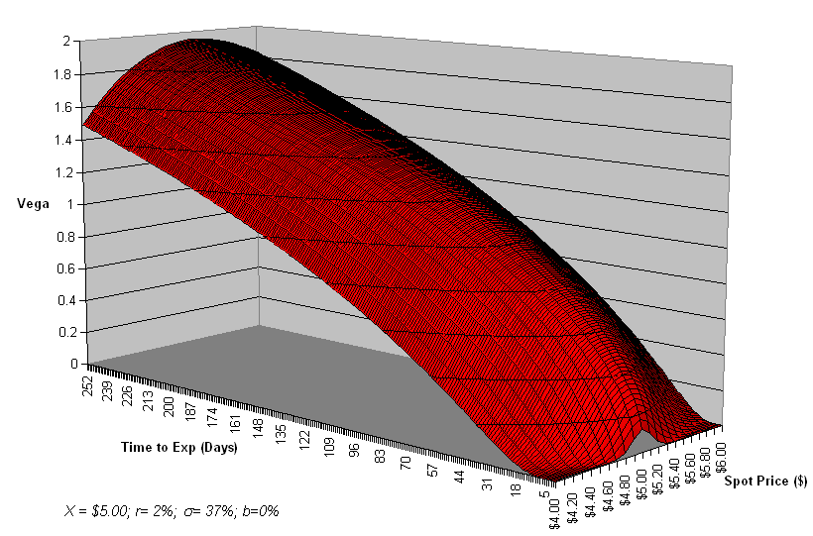
Vega ($5 strike)

Slide 42
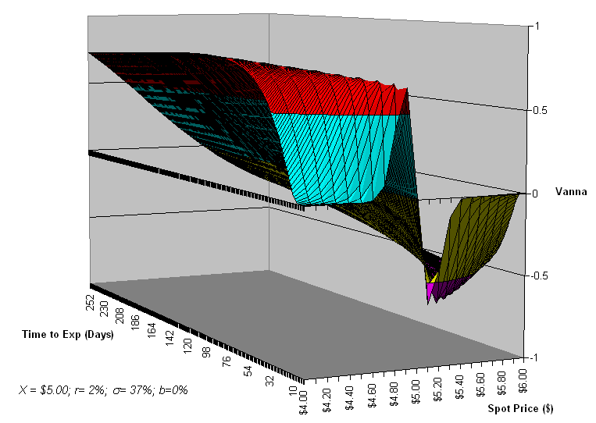
Vanna ($5 strike)
(Change in Delta for a Small Change in Volatility)

Slide 43
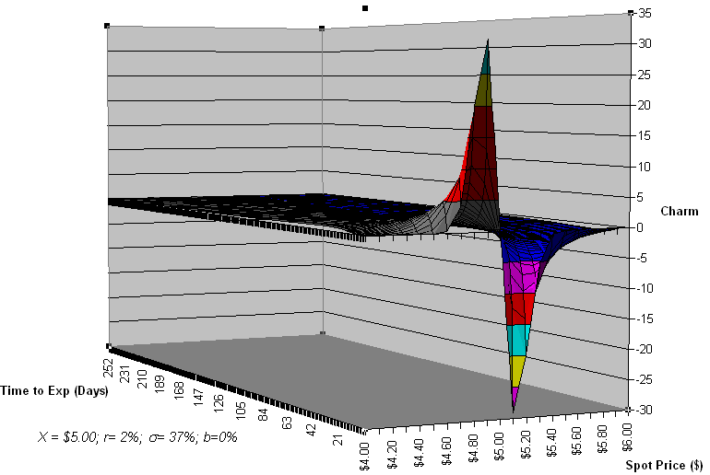
Charm Call ($5 strike)
("Delta Bleeding"- Delta's Sensitivity to Time)

Slide 44
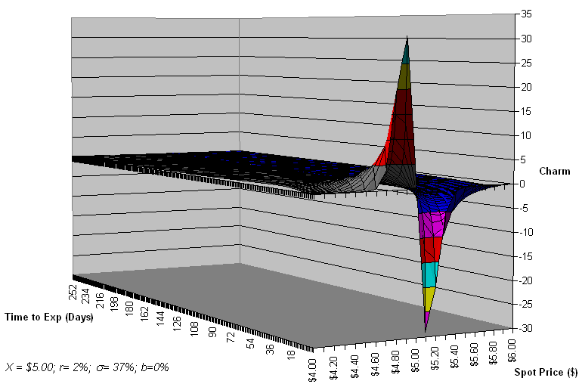
Charm Put ($5 strike)
("Delta Bleeding"- Delta's Sensitivity to Time)

Slide 45
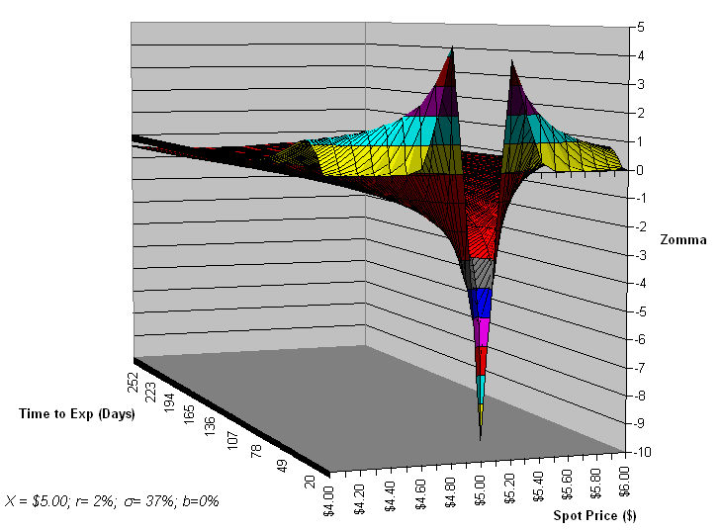
Zomma ($5 strike)
(Changes in Gamma with Respect to Changes in Implied Volatility)

Slide 46
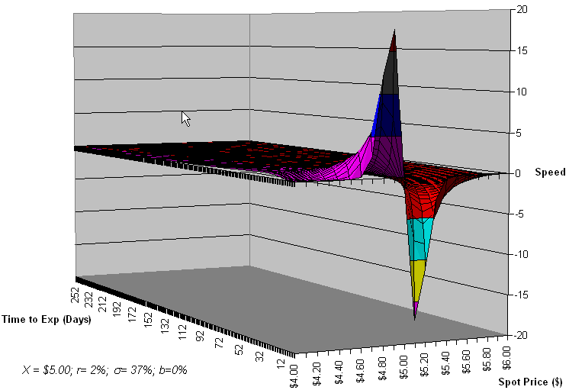
Speed ($5 strike)
(Changes in Gamma with Respect to Changes in Price- Third-Order Derivative)

Slide 47
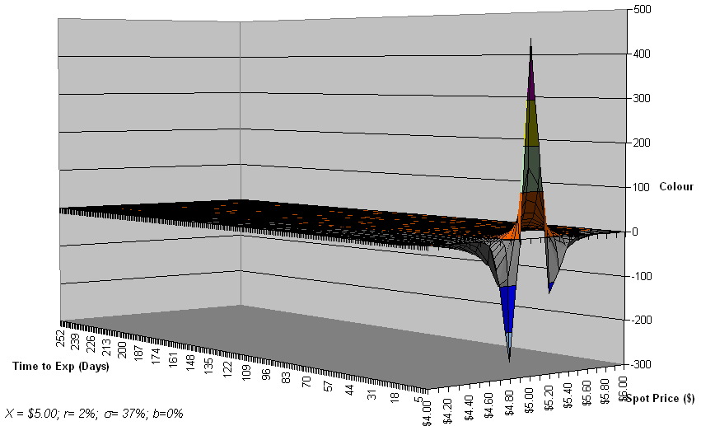
Colour ($5 strike)
(Gamma's Sensitivity to Time Decay)

Slide 48
What Do Greeks Tell You?
 | Positive (Long) | Negative (Short)
Delta | Price increase = portfolio value increase | Price increase = portfolio value decrease
Gamma | Long optionality – downside is limited to option premium paid. Long call – price increases = portfolio value increase. Long put – price decrease = portfolio value increase. | Short optionality – DANGER - downside is unlimited. short call – price increases = portfolio value decrease. Short put – price decrease = portfolio value decrease.
Vega | All else being equal, volatility increases = portfolio value increases | All else being equal, volatility increases = portfolio value decreases
Theta | All else being equal, time increases = portfolio value increases | All else being equal, time increases = portfolio value decreases

Slide 49
Basic Greek Intuition for Risk Analysts
Positive/negative delta = long/short position
Positive/negative gamma = long/short option position (put or call)
Long option positions, usually infer negative theta and positive Vega (all else being equal, the passage of time decreases value of an option while option value increases with volatility increases)

Slide 50
Basic Greek Intuition for Risk Analysts
Short option positions, usually infer positive theta and negative Vega (all else being equal, the passage of time decreases value of an option while option value decreases with volatility increases)

Slide 51
Basic Greek Intuition for Risk Analysts II
Cannot just look at delta to assess market risk
Big difference in risk between positive and negative gamma
Max loss of owning (long) an option (positive gamma) is capped to the option’s premium
Much greater loss potential (risk) associated with writing an option (short gamma)
Theta and Vega are inversely related

Slide 52
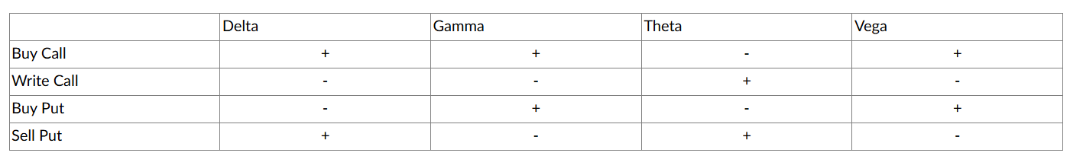
Strategies Revolving Around the Greeks
In theory, a portfolio should be able to be rebalanced very frequently in order to maintain a zero delta, gamma, Vega, and theta.
In practice, usually only delta can be balanced – difficult to find options or other non-linear instruments to rebalance all the Greeks (especially in energy)

Slide 53
Strategies Revolving Around the Greeks II
In most cases, gamma, Vega, and theta are monitored and corrective action is taken when they become too large.
Very important to have limits set around the Greeks

Slide 54
Greeks for a Portfolio

Slide 55
Greeks for Forwards and Futures
Long a Futures Contract
Delta = 1
Gamma = 0
Theta = 0
Vega = 0
Short a Futures Contract
Delta = -1
Gamma = 0
Theta = 0
Vega = 0

Slide 56
A Closer Look at “Delta Neutral”
Creating a delta “zero” position usually through the combination of futures (or forwards) and options.
Offset futures delta position with purchase or sale of options
Number of options used to offset futures/forwards is dependent upon option’s delta measurement (reciprocal of delta)
By using options to get to a delta neutral position – you are increasing volatility (Vega) and time (theta) exposure
Rebalance to a zero delta as market changes
Dynamic hedge vs. static hedge (“put on and forget”)
Purchase/sell futures or forwards to rebalance delta daily or intraday

Slide 57
A Closer Look at “Delta Neutral” II
Pros
Taking directional price movement out of the equation
Method to be long/short volatility
Cons
Prices must move in an orderly fashion without gaps
Potential to fail during times of high volatility – when delta neutral is needed the most

Slide 58
Delta Neutral Example
Portfolio
Long 317 Sept. $17.00 Crude puts at $.48 (delta = -.315)
Long 100 Sept. futures at $17.91 (current price, delta = 1.000)
Position Greeks at $17.91
Position delta | 0
Position gamma | 50.4
Position vega | 9,800
Position theta: | -1,420
Neutralized delta by purchasing 100 futures contracts and 317 puts
Gamma of 50.4 indicates change in delta as price changes
$0.10 upward price movement = portfolio gets bullish (long) by 5 contracts
$0.10 downward price movement = portfolio gets bearish (short) by 5 contracts
Introduced volatility and time exposure
$9,800 loss with a 1% decrease in volatility
$1,420 deterioration for each day
Position will normally make money when volatility increases early on

Slide 59
Comparing the Greeks of Two Different Portfolios
Calculate the Greeks for the following two Portfolios

Slide 60
Portfolio 1
Quantity | Long/Short Put/Call | Price | Strike | Volatility | Time (mos) | Risk-Free Rate
10,000 | Long Call | $5.60 | $5.00 | 37% | 6 | 2%
15,000 | Short Call | $5.20 | $5.50 | 25% | 12 | 2%
20,000 | Long Put | $5.15 | $5.25 | 20% | 15 | 2%
8,0000 | Short Put | $5.40 | $5.20 | 42% | 4 | 2%

Slide 61
Portfolio 2
Quantity | Long/Short Put/Call | Price | Strike | Volatility | Time (mos) | Risk-Free Rate
10,000 | Long Call | $5.00 | $5.60 | 37% | 6 | 2%
15,000 | Long Call | $5.20 | $5.50 | 25% | 12 | 2%
20,000 | Short Put | $5.15 | $5.25 | 20% | 15 | 2%
8,0000 | Short Put | $5.40 | $5.20 | 42% | 4 | 2%

Slide 62
Final Thoughts

